Slide 1
Transaction Management: Crash Recovery
Notes:
The slides for this text are organized into chapters. This lecture covers Chapter 18. It covers logging and recovery, based on the Aries approach.
This is an advanced systems-oriented chapter. It should ideally be covered after the basic foundational systems material on disks and buffer management, and should follow the overview of transaction processing in Chapter 16. It does not depend upon the material on indexing, query processing, and optimization.

Slide 2
Reasons for Crashes
Transaction failures
  Logical errors, deadlocks
System crash
  Power failures, operating system bugs
Disk failure
  Head crashes; for now we will assume
    STABLE STORAGE:
      Data never lost
      using RAID and maintaining geographically distant copies of the data

Slide 3
Recovery
Approach:
  Guarantee A and D:
    by controlling how the disk and memory interact,
    by storing enough information during normal processing to recover from failures
    by developing algorithms to recover the database state
Assumptions:
  System may crash, but the disk is durable
  The only atomicity guarantee is that a disk block write is atomic
Once again, obvious naïve solutions exist that work, but that are too expensive.
  E.g. The shadow copy solution we saw earlier
    Make a copy of the database; do the changes on the copy; do an atomic switch of the dbpointer at commit time
  Goal is to do this as efficiently as possible

Slide 4
Review: The ACID properties
A tomicity: All actions in the Xact happen, or none happen.
C onsistency: If each Xact is consistent, and the DB starts consistent, it ends up consistent.
I solation: Execution of one Xact is isolated from that of other Xacts.
D urability: If a Xact commits, its effects persist.
The Recovery Manager guarantees Atomicity & Durability.

Slide 5
Recovery Manager
Responsible for Atomicity and Durability
Atomicity is ensured by undoing the actions of transactions that do not commit
Durability is ensured by the fact that all the actions of committed transactions survive system crashes

Slide 6
Motivation
Atomicity:
  Transactions may abort (“Rollback”).
Durability:
  What if DBMS stops running? (Causes?)
Desired Behavior after system restarts:
  T1, T2 & T3 should be durable.
  T4 & T5 should be aborted (effects not seen).
crash!
T1
T2
T3
T4
T5

Slide 7
Assumptions
Concurrency control is in effect
  Strict 2PL, in particular
Updates are happening “in place”
  i.e. data is written on (deleted from) the disk

Slide 8
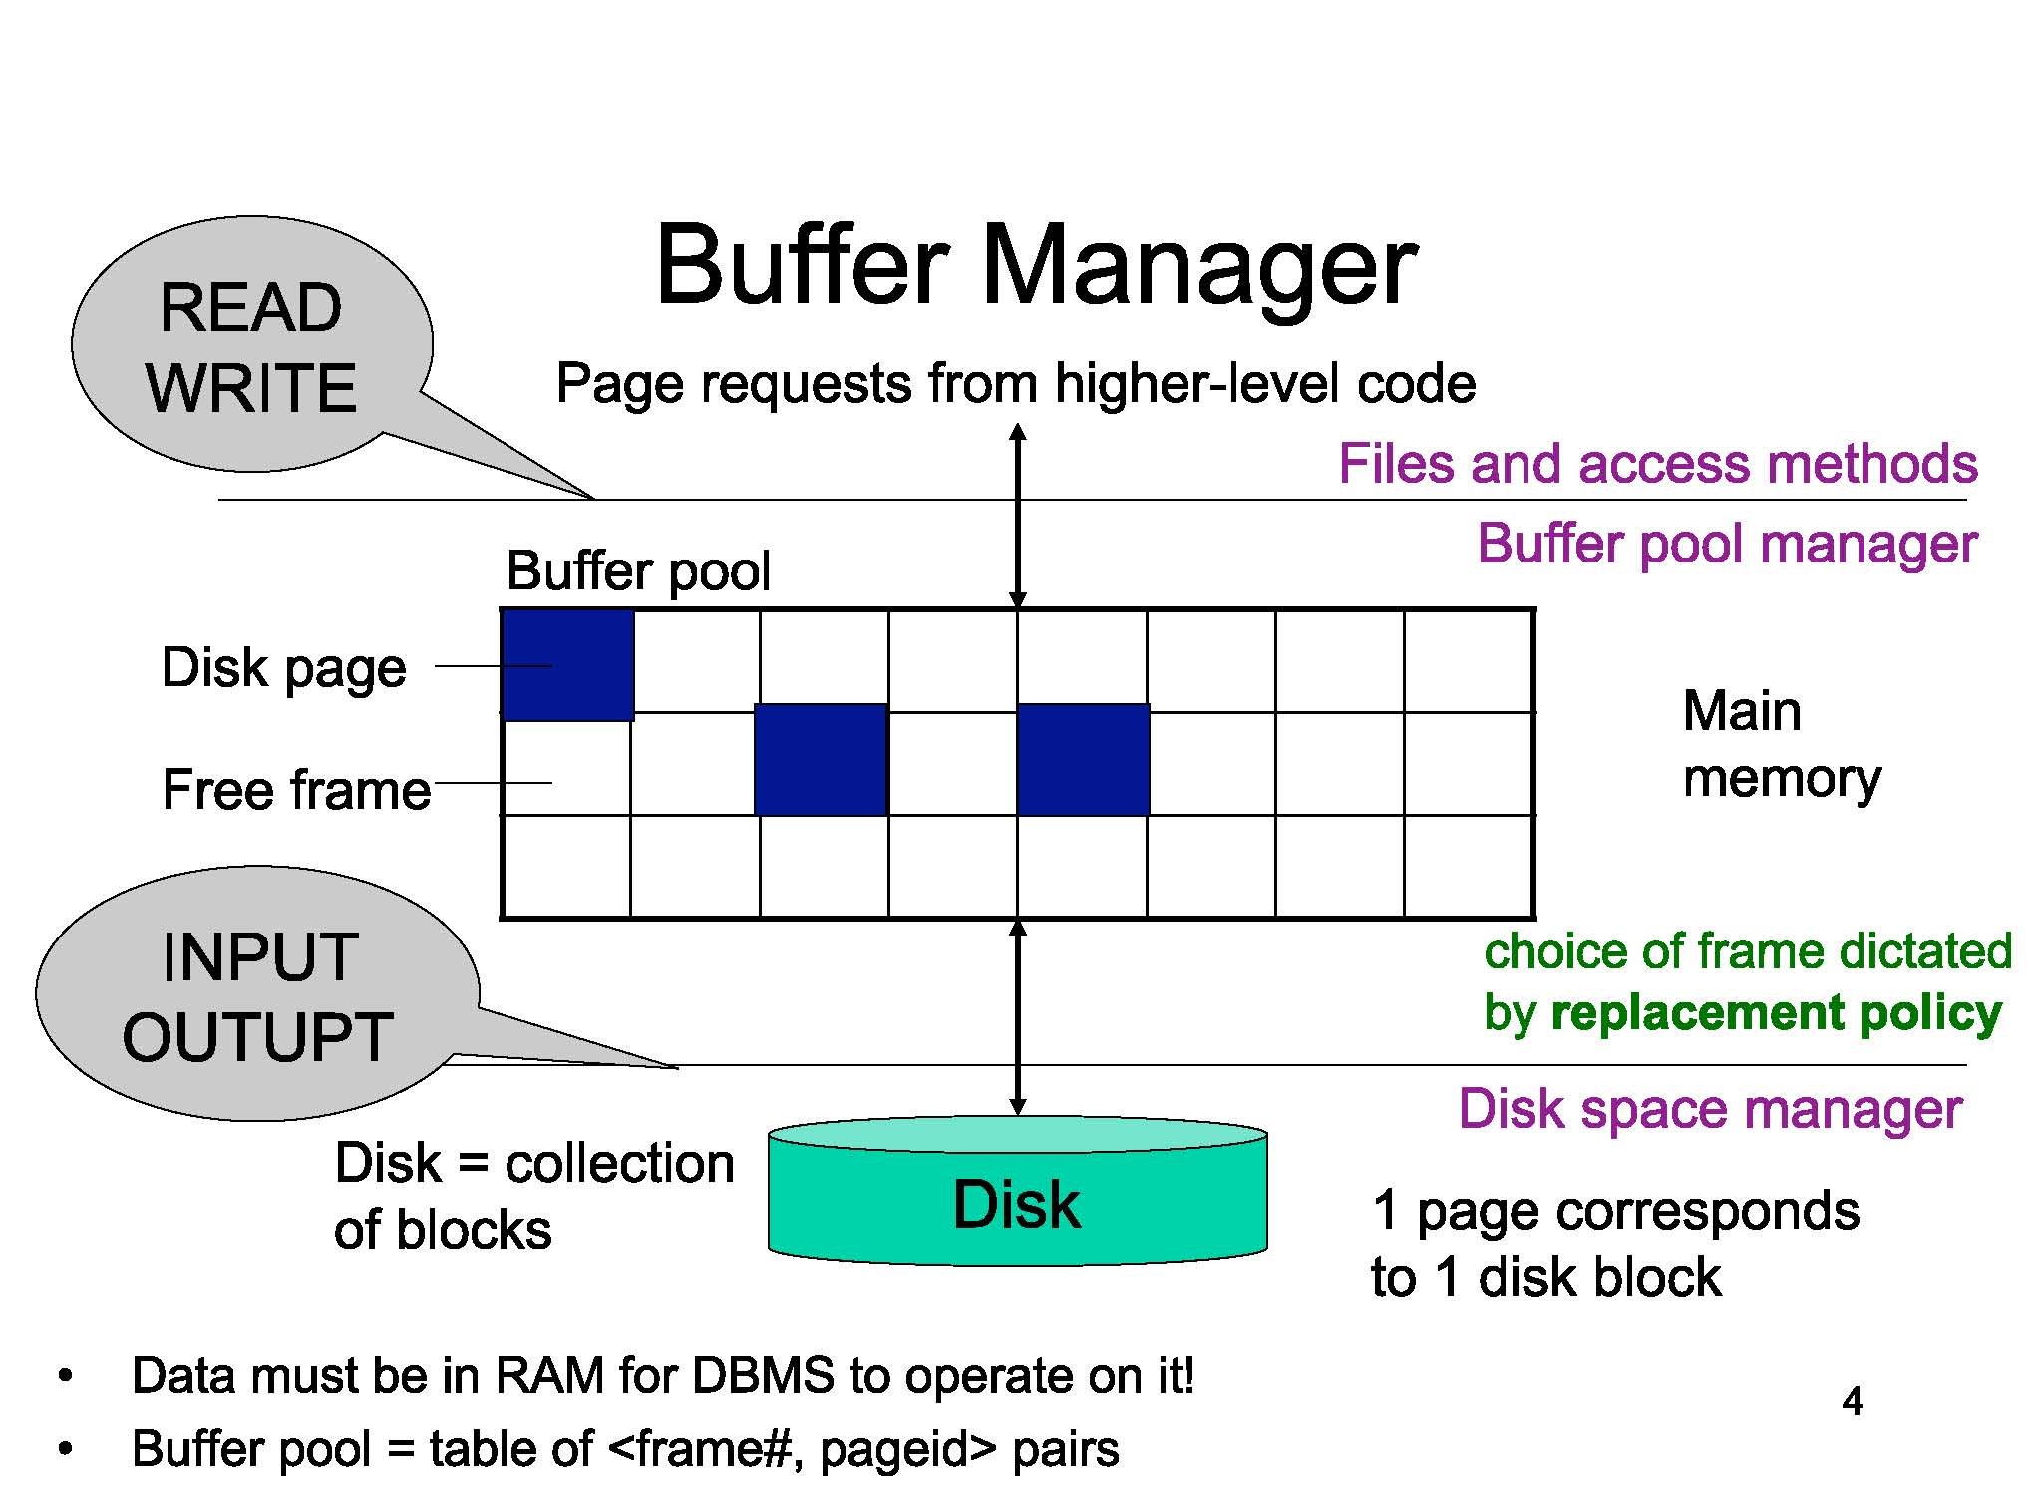

Slide 9
Buffer Management
Steal
  Pages can be written (stolen) from the buffer even if the transaction having modified the pages is still active
  Writing an uncommitted update to disk
  helps to free memory resources
  Without steal DB might consume memory and fail eventually
  Undo logging makes possible to steal pages
  In steal policy the rollback of a transaction requires access to pages on disk in order to reestablish their old state (dirty pages)
No Steal
  Not allowed. More control, but less flexibility for the buffer manager

Slide 10
Buffer Management
Force
  The database system forces all the updates of a transaction to disk before committing
  To make its updates permanent before committing
  Most probably random I/Os, so poor response time and throughput
  Interferes with the disk controlling policies
No Force
  Don’t do the above. Desired
  Guaranteeing durability becomes hard
  We might still have to force some pages to disk, but minimal.

Slide 11
Force Strategy
Is the requirement that all the pages dirtied by transaction are on disk when that transaction commits
No force refers to a system where transaction can commit without writing all updates to disk
No force requires redo logging
Easiest for recovery: no steal, force
Highest performance: steal, no force

Slide 12
Steal & No-Force (1)
Typical DB employs a steal/no-force strategy
Steal strategy : a transaction can be written to disk
before it commits
commit
T1
commit
T2
T3
Time
cache
cache
Can be Used for other transactions (T3)
Updated data by T2
Advantage :
buffer space saving
before T2 commits

Slide 13
Steal & No-Force (2)
No-Force strategy : a transaction need not to be
written to disk immediately
when it commits
commit
Advantage :
I/O operations saving
T1
commit
T2
T3
Time
cache
cache
If T3 needs the same data, it must be copied again
Updated data by T2
← Force strategy
when T2 commits

Slide 14
STEAL vs NO STEAL, FORCE vs NO FORCE:
Recovery implications
Desired
No Force
Trivial
Force
No Steal
Steal

Slide 15
Buffer Manager Policy
Steal/ no steal
  Can an update made by uncommitted transaction overwrite the most recent committed value of a data item on disk?
Force/ no force
  Should all updates of a transaction be forced to disk before the transaction commits
Easiest for recovery: no steal, force
Highest performance: steal, no force

Slide 16
UNDO Policy
Steal, no force
When steal is needed but force is not
    Long running transactions
    Space constrained transactions

Slide 17
REDO Policy
When no force, no steal is used
Short transactions (OLTP)
Redo/Undo: steal, no force
Fast commit, space management

Slide 18
no force, steal
For frequently changed objects, a no-force policy allows updates to be merged and so reduce the number of write operations to the actual database object
A no-force policy also reduces the seek time required for a commit by having mostly sequential write operations to the transaction log, rather than requiring the disk to seek to many distinct database objects during a commit.

Slide 19
ARIES
  ARIES: A Transaction Recovery Method Supporting Fine Granularity Locking and Partial Rollback Using Write-Ahead Logging
  C. Mohan, D. Haderle, B. Lindsay, H. Pirahesh, and P. Schwarz
  ACM Transactions on Database Systems, 17(1), 1992

Slide 20
ARIES
Algorithms for Recovery and Isolation Exploiting Semantics ARIES
Write ahead logging: Any change to an object is first recorded in the log, and the log must be written to stable storage before changes to the object are written to disk.
Repeating history during Redo: On restart after a crash, ARIES retraces the actions of a database before the crash and brings the system back to the exact state that it was in before the crash. Then it undoes the transactions still active at crash time.
Logging changes during Undo: Changes made to the database while undoing transactions are logged to ensure such an action isn't repeated in the event of repeated restarts.

Slide 21
ARIES
ARIES is recovery algorithm which is designed to work with steal, no force approach
When the recovery manager is invoked after crash, restart proceeds in three phases:
Analysis Identifies dirty pages in the buffer pool (changes that haven't been written to the disk) and active transactions at the time of crash
Redo Repeats all actions, starting from an appropriate point in the log, and restores the database state to what it was at the time of the crash
Undo Undoes the actions of transactions which did not commit, so that only actions of the committed transactions are there in the database

Slide 22
Schedule with a Crash
T1(p5),T2(p3),T2 Commit, T2 End, T3 writes p1, T3 writes p3, CRASH, RESTART
When the system is restarted after crash, the analysis phase identifies T1 and T3 as transactions active at the time of the crash and therefore to be UNDONE
T2 has committed transaction and all its actions are written to the disk
P1,p3,p5 are dirty pages
All the updates (including those of T1 and T3) are reapplied during REDONE phase
Actions of T1 and T3 are UNDONE in reverse order during UNDO phase (T3’s write of p3 is undone, T1’s write of p1 is undone)

Slide 23
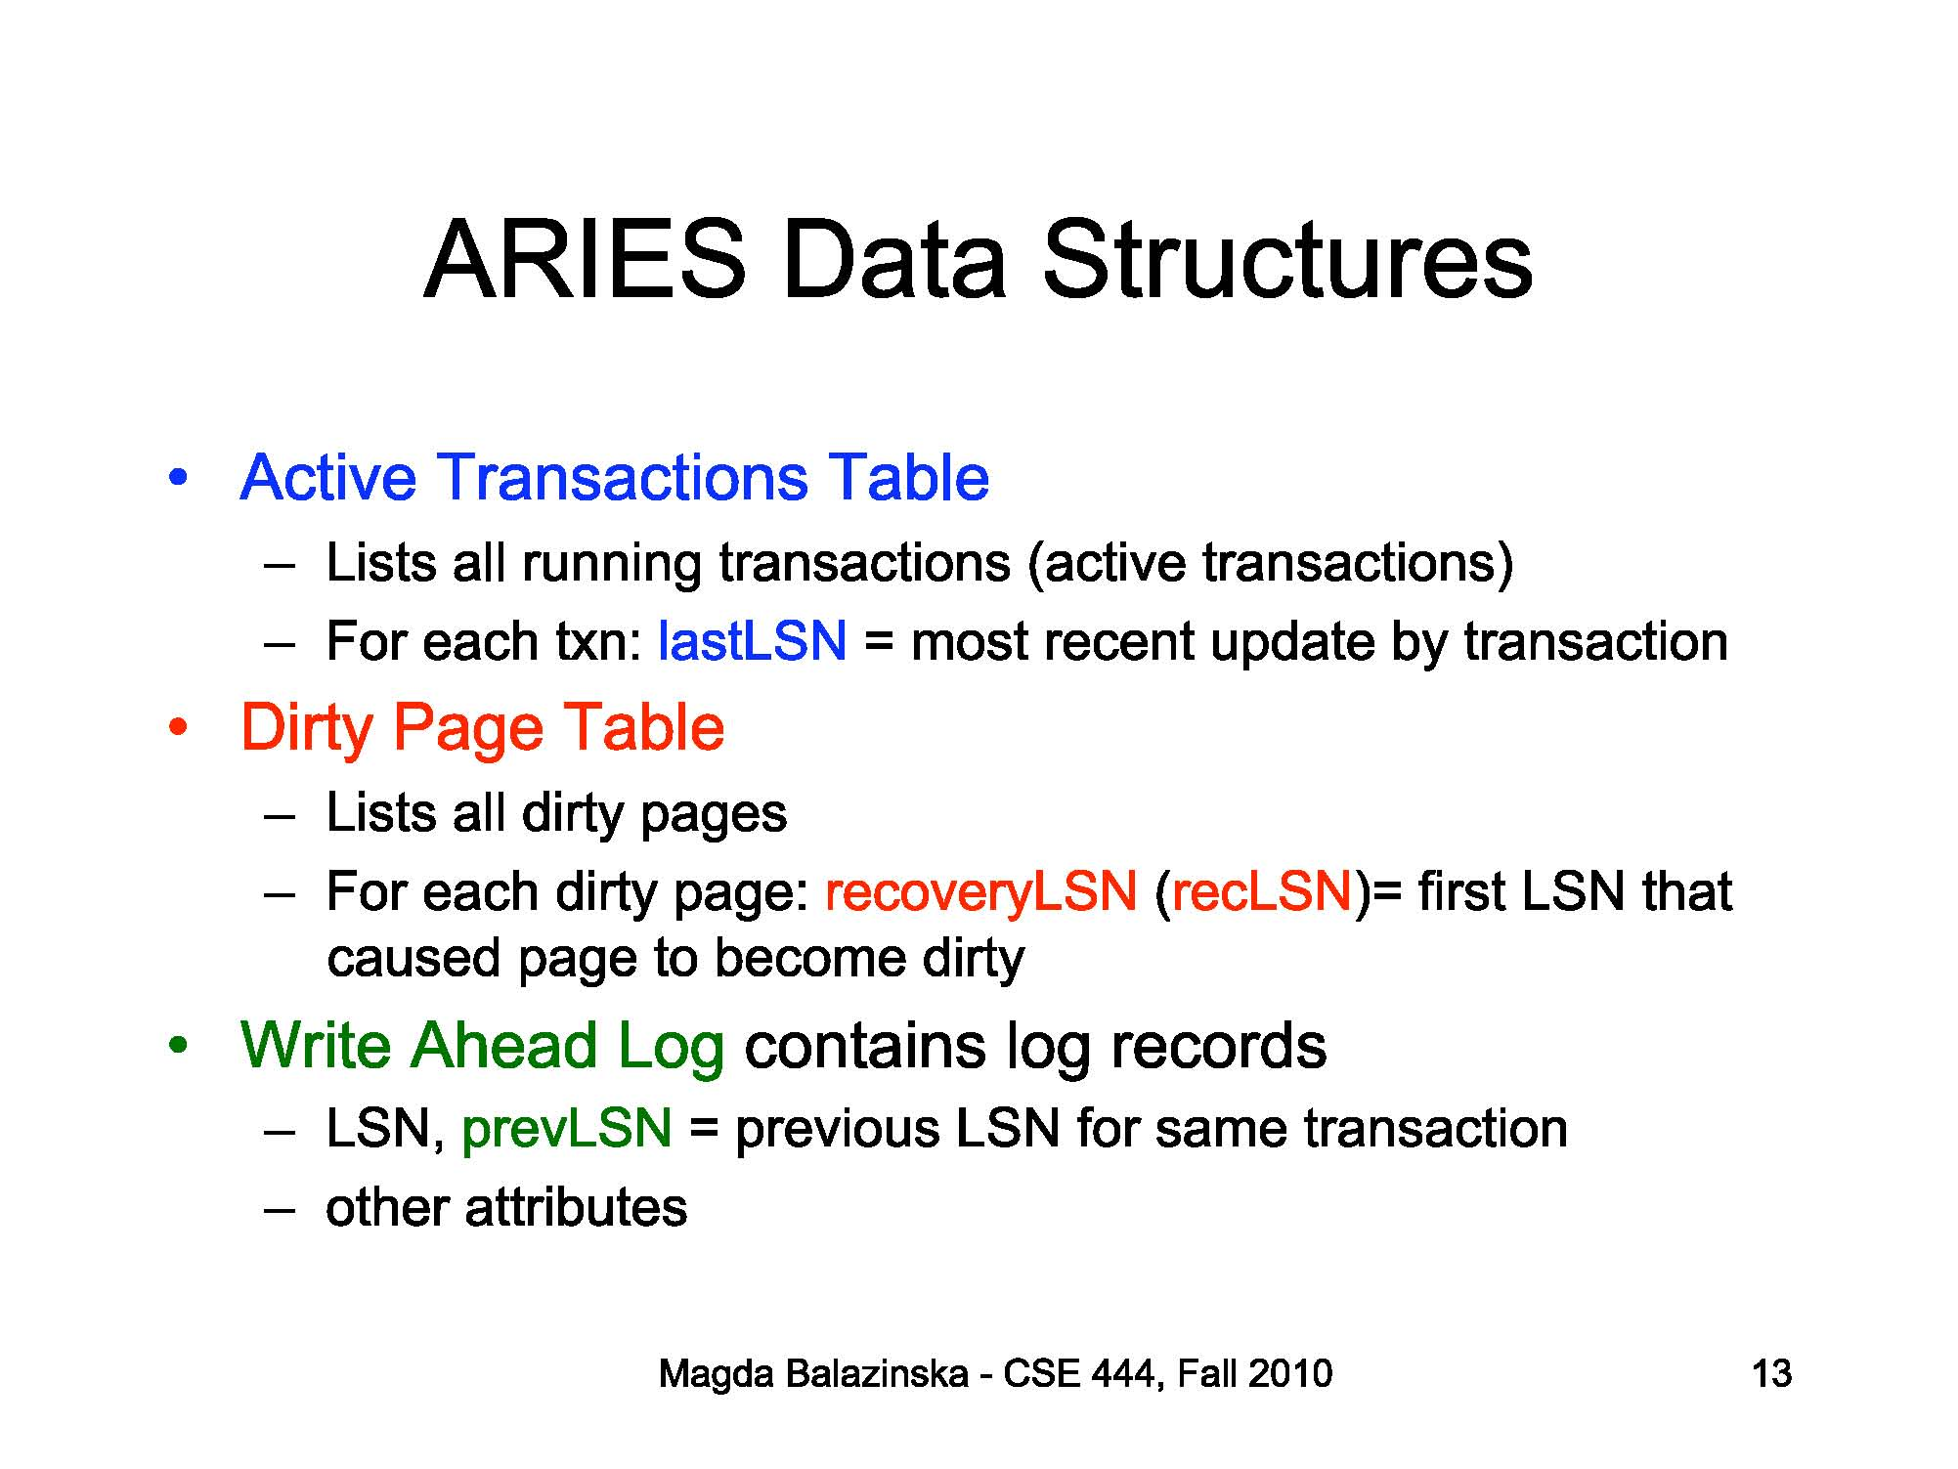

Slide 24
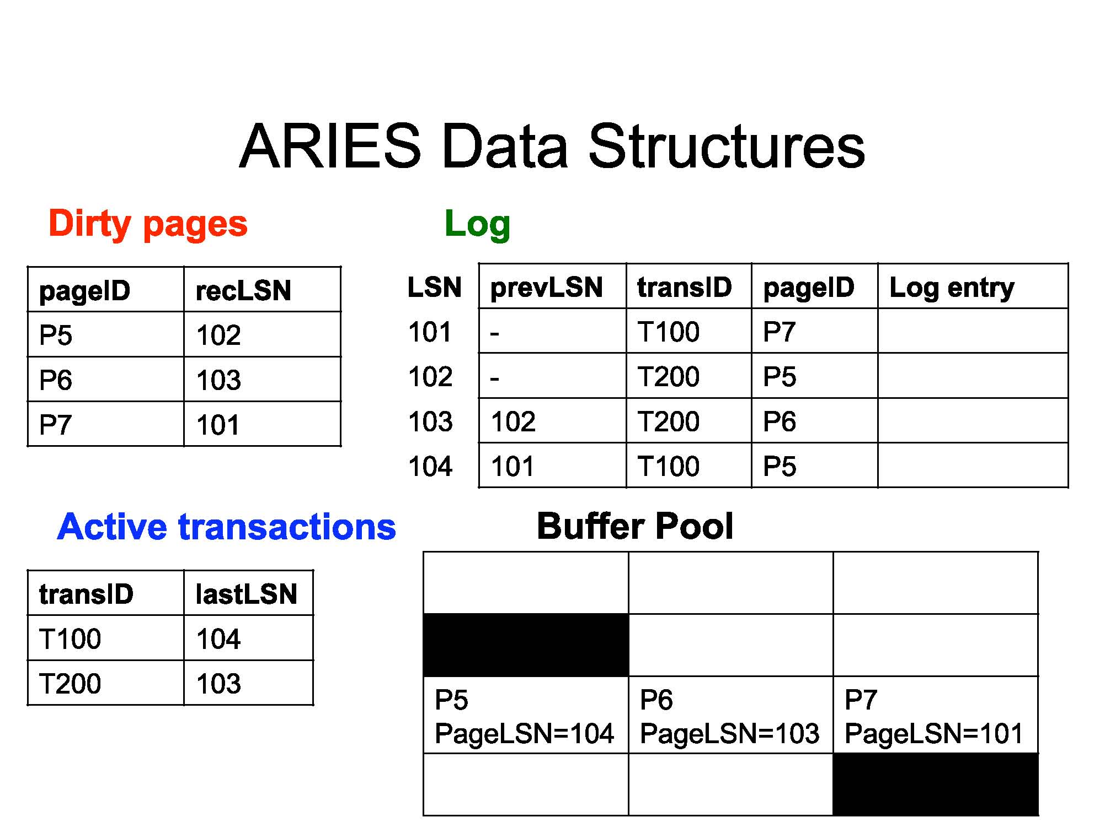

Slide 25
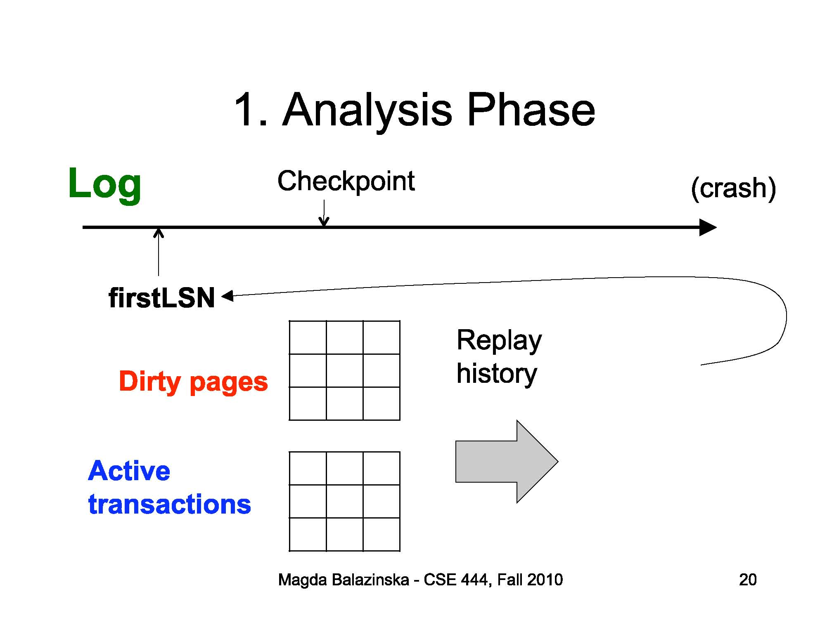

Slide 26
AIRES
Three main principles lie behind ARIES:
Write ahead logging: Any change to an object is first recorded in the log, and the log must be written to stable storage before changes to the object are written to disk.
Repeating History during Redo: On restart after a crash, ARIES retraces the actions of a database before the crash and brings the system back to the exact state that it was in before the crash. Then it undoes the transactions still active at crash time.
Logging changes during UNDO: Changes made to the database while undoing transactions are logged to ensure such an action isn't repeated in the event of repeated restarts.

Slide 27
LOG/TRAIL/JOURNAL
A file of records stored in the storage
Recent portion of LOG is LOG TAIL
Every LOG RECORD has unique id called log sequence number LSN
LSNs have been assigned monotonically increasing number
pageLSN for recovery purposes, every page in the database contains the LSN of the most recent log record that describes a change to this page

Slide 28
LOG Records Type
Update, Commit, Abort, End, CLR
Updating Page: update type record. pageLSN of the page is set to LSN of the update log record
Abort : when transaction is aborted, an abort record containing xact id is appended to the LOG, and UNDO is initiated for this xact.
Commit: When a transaction commits it force-writes a commit type log record containing transaction ID (LOG tail containing commit record – log tail including and upto commit record- is written to a stable storage). The transaction is removed from active transaction table
End: when xact is aborted or committed, some additional work needs to be done beyond writing the abort or commit log record
End type log record containing the xactid is appended to the LOG
Compensation Log Record: Undoing an update when a xact is rolled back (transaction aborted or during recovery from crash) , its updates are undone. When the action described by an update LOG record is undone, a compensation log record CLR is written

Slide 29
LOG contd…..
Every LOG record has prevLSN, transID, and type
The set of all log records for a transaction are maintained as a linked list going back in time, using prevLSN field
Using prevLSN this list must be updated whenever a log record is added
transID is the ID of the transaction generating that log record
Type: indicates type of the log record

Slide 30
LOG records
Fields common to all log records: prevLSN, transID, type
Update log record fields: pageID, length, offset, before-image, after-image
pageID: pageID of the modified page
Length: in bytes
Offset: of the change
Before-image: the value of the changed bytes before change
After-image: the value after the change
Before,after image data can be used to REDO the change and UNDO it

Slide 31
Compensation LOG Records
CLR is written just before the change recorded in an update log record U is undone (abortion/recovery)
Records actions taken to undo the actions recorded in the corresponding log record and appended to log tail just like any other log record
CLR C also contains a field undoNextLSN which is LSN of the next log record that is to be undone for the transaction that wrote update record U, this field in C is set to the value of prevLSN in U

Slide 32
Basic Idea: Logging
Record REDO and UNDO information, for every update, in a log.
  Sequential writes to log (put it on a separate disk).
  Minimal info (diff) written to log, so multiple updates fit in a single log page.
Log: An ordered list of REDO/UNDO actions
  Log record contains:
    <XID, pageID, offset, length, old data, new data>
  and additional control info may be included
Notes:
7

Slide 33
Write-Ahead Logging (WAL)
The Write-Ahead Logging Protocol:
  Must force the log record for an update before the corresponding data page gets to disk
  Must write all log records for a Xact before commit.
#1 guarantees Atomicity
#2 guarantees Durability
Exactly how is logging (and recovery!) done?
  ARIES algorithm

Slide 34
WAL & the Log
DB
RAM
LSNs
pageLSNs
flushedLSN
Each log record has a unique Log Sequence Number (LSN).
  LSNs always increasing.
Each data page contains a pageLSN.
  The LSN of the most recent log record for an update to that page.
System keeps track of flushedLSN.
  The max LSN flushed so far.
WAL: Before a page is written,
  pageLSN ≤ flushedLSN
Log records
flushed to disk
pageLSN
“Log tail”
in RAM

Slide 35
Log Records
Possible log record types:
Update
Commit
Abort
End (signifies end of commit or abort)
Compensation Log Records (CLRs)
  for UNDO actions
LogRecord fields:
prevLSN
XID
type
pageID
update
records
only
length
offset
before-image
after-image

Slide 36
Other Recovery-Related Structures
Transaction Table: (transaction manager)
  One entry per active Xact
  Contains XID, status (running/ commited /aborted), and lastLSN (most recent log record for this transaction)
  lastLSN is the LSN of the most recent log record for this transaction
Dirty Page Table: (buffer manager)
  One entry per dirty page in buffer pool
  pageID
  Contains recLSN -- the LSN of the log record which first caused the page to be dirty
  This LSN identifies the earliest log record that might have to be redone for this page during restart from crash

Slide 37
Normal Execution of an Xact
Series of reads & writes, followed by commit or abort.
  We will assume that write is atomic on disk.
    In practice, additional details to deal with non-atomic writes.
Strict 2PL.
NO-FORCE buffer management, with Write-Ahead Logging.

Slide 38
WAL
WAL ensures that record of every change to the database is available while attempting to recover from a crash
Before writing a page to the disk, every update record that describes change to this page must be forced to stable storage
This is accomplished by forcing all log records upto and including the one with LSN equal to the pageLSN to stable storage before writing the page to disk
When a transaction is committed, the log tail is forced to stable storage even if no force approach is being used
If a force approach is used all the pages modified by the transaction rather than a portion of the log that includes all its records must be forced to disk when the transaction commits
The set of all changed pages is larger than the log tail

Slide 39
Checkpointing
A checkpoint is like a snapshot of DBMS state
By taking checkpoints periodically the DBMS can reduce the amount of work to be done during restart in the event of a subsequent crash
Data and log records are written to disk
begin_checkpoint record: Indicates when chkpt began.
end_checkpoint record: Contains current contents of the Xact table and dirty page table.
Third step is carried out after end-checkpoint record is written to stable storage
Special master record containing LSN of begin checkpoint log record is written to stable storage
Other Xacts continue to run; so these tables accurate only as of the time of the begin_checkpoint record.
No attempt to force dirty pages to disk; effectiveness of checkpoint limited by oldest unwritten change to a dirty page. (So it’s a good idea to periodically flush dirty pages to disk!)
Store LSN of chkpt record in a safe place (master record)

Slide 40
The Big Picture:
What’s Stored Where
LOG
RAM
DB
LogRecords
Xact Table
lastLSN
status
Dirty Page Table
recLSN
prevLSN
Data pages
each
with a
pageLSN
XID
type
pageID
length
offset
master record
before-image
after-image

Slide 41
Simple Transaction Abort
For now, consider an explicit abort of a Xact.
  No crash involved.
We want to “play back” the log in reverse order, UNDOing updates.
  Get lastLSN of Xact from Xact table.
  Can follow chain of log records backward via the prevLSN field.
  Before starting UNDO, write an Abort log record.
    For recovering from crash during UNDO!

Slide 42

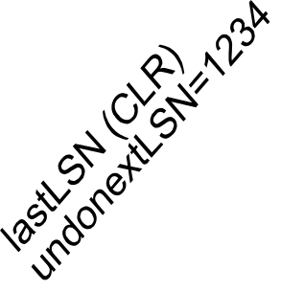
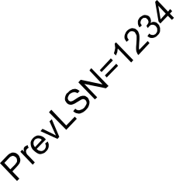
Abort, cont.
To perform UNDO, must have a lock on data!
  No problem!
Before restoring old value of a page, write a CLR:
  You continue logging while you UNDO!!
  CLR has one extra field: undonextLSN
    Points to the next LSN to undo (i.e. the prevLSN of the record we’re currently undoing).
  CLRs never Undone (but they might be Redone when repeating history: guarantees Atomicity!)
At end of UNDO, write an “end” log record.

Slide 43
Transaction Commit
Write commit record to log.
All log records up to Xact’s lastLSN are flushed.
  Guarantees that flushedLSN ≥ lastLSN.
  Note that log flushes are sequential, synchronous writes to disk.
  Many log records per log page.
Commit() returns.
Write end record to log.

Slide 44
Crash Recovery: Big Picture
Oldest log rec. of Xact active at crash
Start from a checkpoint (found via master record).
Three phases. Need to:
  Figure out which Xacts committed since checkpoint, which failed (Analysis).
  REDO all actions.
    (repeat history)
  UNDO effects of failed Xacts.
Smallest recLSN in dirty page table after Analysis
Last chkpt
CRASH
A
R
U

Slide 45
Analysis phase
It determines the point in the log at which to start the REDO (smallest recLSN of any dirty page)
It determines the pages in the buffer pool which were dirty at the time of the crash
It identifies transactions that were active at the time of the crash and must be undone
Analysis begins by examining most recent begin-checkpoint log record and initializing the transaction and dirty page table to those structures in the next end-checkpoint record
Analysis scans log in forward direction
If and end log record for a transaction T is encountered, T is removed from the TT because it is no longer active

Slide 46
Analysis phase contd…
If a log record other than end record for a transaction T is encountered, an entry for T is added to the TT if it is not already there
Entry for T is modified to :
  The lastLSN field is set to the LSN of this log record
  If log record is commit record, the status is set to C, otherwise it is set to U (to be undone)
If a redoable log record affecting page P is encountered, and P is not in dirty page table, an entry is inserted into this table with pageID P and recLSN equal to the LSN of this redoable log record
This LSN identifies the oldest change affecting page P that may not have been written to the disk

Slide 47
Analysis phase contd…
At the end of the analysis phase:
  The TT contains list of all active transactions at the time of the crash (trans with status U)
  The dirty page table includes all pages that were dirty at the time of the crash but may also contain some pages that were written to disk

Slide 48
Recovery: The Analysis Phase
Reconstruct state at checkpoint.
  via end_checkpoint record.
Scan log forward from checkpoint.
  End record: Remove Xact from Xact table.
  Other records: Add Xact to Xact table, set lastLSN=LSN, change Xact status on commit.
  Update record: If P not in Dirty Page Table,
    Add P to D.P.T., set its recLSN=LSN.

Slide 49
Redo Phase
During REDO ARIES reapplies the updates of all transactions, committed or otherwise
If a transaction is aborted before crash and its updates were undone, as indicated by CLR, the actions in CLRs are also reapplied
  (repeating history)
This makes possible recovering the state of the database at the crash time exactly during recovery
Begins with smallest recLSN of all pages in DPT constructed during analysis phase as this LSN of record identifies the oldest update that may not have been written to disk prior to crash
REDO scans forward from this point until end of log
For each redoable (Update or CLR) log record, redo checks whether the logged action must be redone

Slide 50
Redo Phase
The action must be redone unless one of the following conditions hold:
  The affected page is not in the dirty page table
    Means all changes to this page have already been written to the disk
  It is in DPT but the recLSN for the entry is greater than the LSN for the log record being checked
    Because the recLSN is the first update to this page that may not have been written to the disk, the second condition means that the update being checked was indeed propagated to disk

Slide 51
Redo Phase
The pageLSN (stored on the page, which must be retrieved to check this condition) is greater than or equal to the LSN of the log record being checked
  This requires to retrieve the page, ensures that the update being checked was written to disk, because either this update or a later update to the page was written
If the logged action must be redone:
  The logged action is reapplied
The pageLSN on the page is set to the LSN of the redone log record. No additional log record is written at this time

Slide 52
Recovery: The REDO Phase
We repeat History to reconstruct state at crash:
  Reapply all updates (even of aborted Xacts!), redo CLRs.
Scan forward from log rec containing smallest recLSN in D.P.T. For each CLR or update log rec LSN, REDO the action unless:
  Affected page is not in the Dirty Page Table, or
  Affected page is in D.P.T., but has recLSN > LSN, or
  pageLSN (in DB) ≥ LSN.
To REDO an action:
  Reapply logged action.
  Set pageLSN to LSN. No additional logging!

Slide 53
Undo phase
Scans backward from the end of the log
Undo all actions of all transactions those were active at the time of the crash
TT constructed by analysis phase identifies all active transactions
Includes LSN of most recent log record (lastLSN) for each such transaction (such transactions are loser transactions)
All actions of losers must be undone in the reverse of the order they appear in the log
Set of lastLSN values for all loser transactions …is called ToUndo
Undo repeatedly chooses the largest LSN (most recent) in this set and processes it, until ToUndo is empty

Slide 54
Undo phase
To process a log record:
  If it is CLR and the undoNextLSN value is not NULL, the undoNextLSN value is added to the set ToUndo; if undoNexLSN is null an end record is written for the transaction because it is completely undone and the CLR is discarded
  If it is an update record, a CLR is written and the corresponding action is undone and prevLSN value in the log record is added to the set ToUndo
  When set ToUndo is empty, the undo phase is complete.
  Restart is now complete

Slide 55
Recovery: The UNDO Phase
ToUndo={ l | l a lastLSN of a “loser” Xact}
Repeat:
  Choose largest LSN among ToUndo.
  If this LSN is a CLR and undonextLSN==NULL
    Write an End record for this Xact.
  If this LSN is a CLR, and undonextLSN != NULL
    Add undonextLSN to ToUndo
  Else this LSN is an update. Undo the update, write a CLR, add prevLSN to ToUndo.
Until ToUndo is empty.

Slide 56
Instance of LOG and TT
T1000 changes value of bytes 21 to 23 on page P500 from ABC to DEF
T2000 changes HIJ to KLM on P600
T2000 changes bytes 20 to 22 from GDE to QRS on P500
T1000 changes TUV to WXY on P505
Older records at top and newer at bottom

Slide 57
Analysis Phase
If T2000 commits, T1000 modifies another page P700 and appends an update record to log tail and then system crashes (before update record is written to stable storage)
DPT and TT are lost in crash
Suppose most recent checkpoint has DPT and TT empty
Analysis initializes these 2 tables to be empty
Scanning forward in log, T1000 is added to TT, P500 is added to DPT with recLSN equal to LSN of the first shown log record
T2000 is added to TT and P600 to DPT
There is no change based on the third log record and fourth record results in the addition of P505 to DPT
(suppose) The commit record for T2000 is encountered and T2000 is removed from the TT

Slide 58
A
Analysis is complete
Only active xact at crash time is T1000, with lastLSN equal to LSN of the fourth record in LOG instance
Update log record for change to P700 is lost in crash and not seen in analysis phase
If P600 change is written to disk before crash, P600 is not dirty then, yet it is there in DPT
pageLSN on P600 however reflects the write because it is now equal to the LSN of the second update log record in log instance

Slide 59
Redo
From DPT the smallest recLSN is seen to be the LSN of first Log record of log instance
Means changes recorded by earlier log records have been written to the disk before crash
Redo fetches affected page P500, and compares LSN for this log record with pageLSN on the page and because we assumed that this page was not written to the disk before crash, finds that the pageLSN (most recent log record describing change to this page) is less
The update is therefore reapplied, bytes 21 to 23 are changed to DEF and pageLSN is set to the LSN of this update log record

Slide 60
R
Redo examines second log record
Affected page P600 is fetched and pageLSN is compared to LSN of the Update record
In this case, because we assumed that P600 was written to disk before crash, they are equal and update doesn’t have to be redone
Note that the first 2 conditions indicating that a redo is unnecessary never hold in this example

Slide 61
Undo
T1000 was active xact at crash time
From TT we get LSN of most recent log record which is fourth update log record in log instance
The update is undone
CLR is written with undonextLSN equal to LSN of the first log record
Next record to be undone is T1000
After this is undone, a CLR and an end log record for T1000 is written and undo is complete
Here, undoing the action recorded in the first log record causes the action of the third log record which is due to committed transaction, to be overwritten and lost
This happens because T2000 overwrote a data item written by T1000 while T1000 was still active (if strict 2PL is followed T2000 cant overwrite

Slide 62
Aborting a Transaction
Special case of undo phase of restart in which single transaction rather than a set of transactions is undone

Slide 63
Example of Recovery
LSN LOG
RAM
00
05
10
20
30
40
45
50
60
begin_checkpoint
end_checkpoint
update: T1 writes P5
update T2 writes P3
T1 abort
CLR: Undo T1 LSN 10
T1 End
update: T3 writes P1
update: T2 writes P5
CRASH, RESTART
Xact Table
lastLSN
status
Dirty Page Table
recLSN
flushedLSN
prevLSNs
ToUndo

Slide 64
Crash Recovery using AIRES
LSN are in ascending order
Each log record for a transaction has a prevLSN field that points to the previous log record for that transaction
Null prevLSN value can be used for the first record in the log for transaction
LSN 30: T1 aborts
All actions of T1 should be undone in reverse order
Only action of T1 described by the update log record 10 is indeed undone as indicated by CLR40
After first crash, analysis identifies P1 (with recLSN = 50), P3( with recLSN = 20) and P5 (with recLSN =10) as dirty pages
Log record 45 shows that T1 is a completed transaction

Slide 65
AIRES for crash recovery
TT identifies T2 with lastLSN 60 and T3 with lastLSN 50 as active at the time of the crash
The redo phase begins with log record 10 which is minimum recLSN in the dirty page table
All actions (for update and CLR records) are reapplied
The ToUndo set consists of LSNs 60, for T2, and 50, for T3
The undo phase begins by processing the log record with LSN 60 because 60 Is the largest LSN in the ToUndo set
The update is undone, and a CLR (with LSN 70) is written to the log
this CLR has undoNextLSN equal to 20, which is prevLSN value in the log record 60; 20 is the next action to be undone for T2

Slide 66
AIRES for crash recovery (2)
Now the largest remaining in ToUndo set is 50
The write corresponding to log record 50 is now undone and a CLR describing the change is written
This CLR has LSN 80, and its UndoNextLSN field is null because 50 is the only log record for transaction T3
Therefore T3 is completely undone, and End record has been written
Log records 70,80,85 are written to a stable storage before the system crashes a second time
The changes described by these records may not have been written to the disk

Slide 67
AIRES for crash recovery (after repeated crash)
When system is restarted after the second crash, analysis determines that the only active transaction at the time of the crash was T2
The dirty page table is identical to what it was during previous restart
Log records 10 through 85 are processed again during redo
If some of the changes made during previous redo are written to the disk, the pageLSN on the affected pages are used to detect this situation and avoid writing these pages again
The undo phase considers only LSN in the ToUndo set, 70, and processes it by adding UndoNextLSN value (2o)to the ToUndo
Next, log record 20 is processed by undoing T2’s write of page P3 and a CLR is written (LSN90)

Slide 68
AIRES
Because 20 is the first of T2’s log records, and therefore, the last of its record to be undone
The UndoNextLSN in this CLR is Null, and end record is written for T2 and the ToUndo set is empty
Recovery is complete and normal execution of
System crashes again and system is in undo phase (already discussed
If crash occurs during analysis phase, all the work done in this phase is lost and on restart the analysis phase starts afresh with same information as before
If crash happens during redo phase, the only effect that survives crash is that some of the changes made during redo may have been written to the disk prior to crash

Slide 69
AIRES
Restart starts again with the analysis phase and then the redo phase and some update log records that were redone the first time around will not be redone a second time because the pageLSN is now equal to the update record’s LSN

Slide 70
Example: Crash During Restart!
LSN LOG
00,05
10
20
30
40,45
50
60
70
80,85
90
begin_checkpoint, end_checkpoint
update: T1 writes P5
update T2 writes P3
T1 abort
CLR: Undo T1 LSN 10, T1 End
update: T3 writes P1
update: T2 writes P5
CRASH, RESTART
CLR: Undo T2 LSN 60
CLR: Undo T3 LSN 50, T3 end
CRASH, RESTART
CLR: Undo T2 LSN 20, T2 end
RAM
undonextLSN
Xact Table
lastLSN
status
Dirty Page Table
recLSN
flushedLSN
ToUndo

